Slide 1
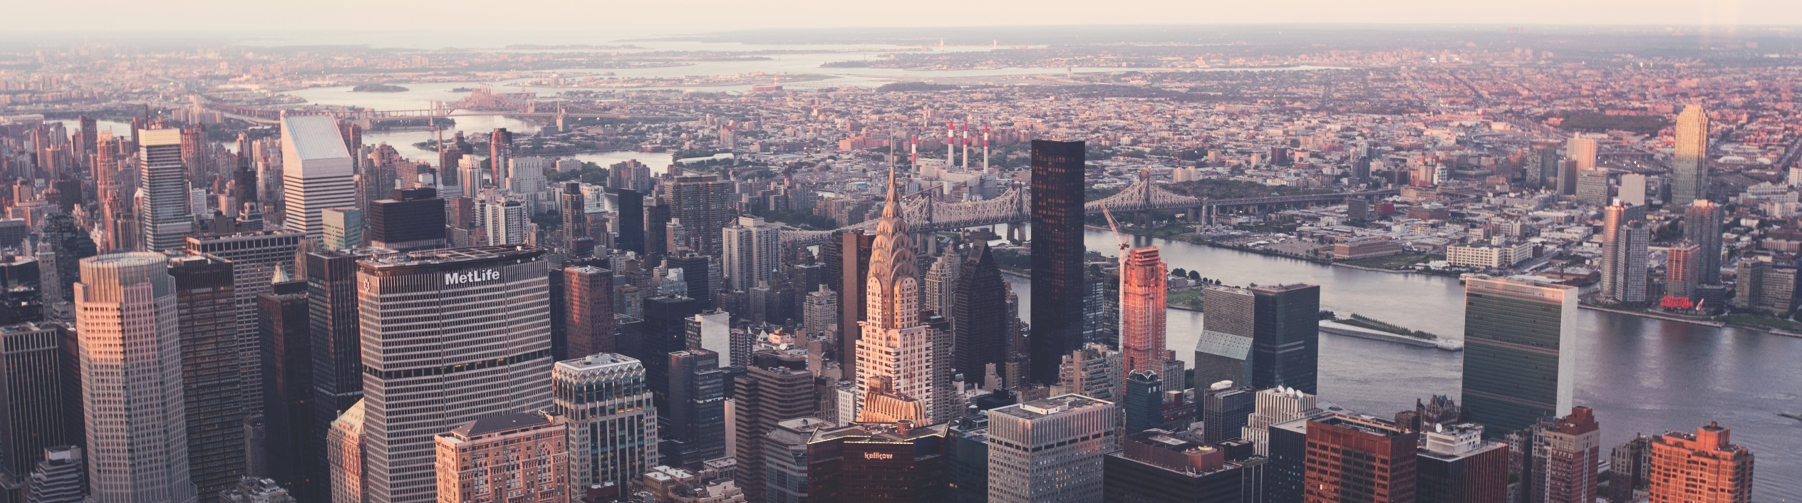
Locating next Chipotle by Kanishk Mair

Slide 2
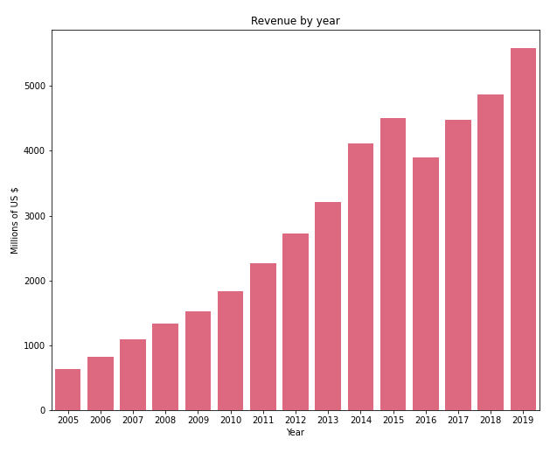
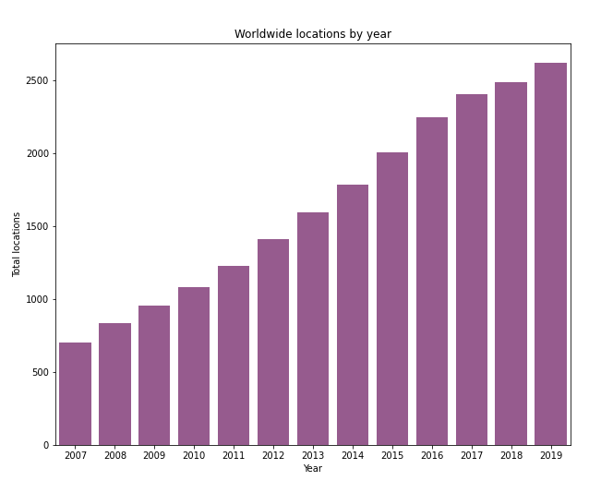
problem description: Finding best location for the franchise in bloominton, il
Chipotle, is a fast food chain serving Mexican cuisine
It has simultaneously been expanding its locations, and
this project's goal is to find a new location in Bloomington
It's revenues have been increasing by year

Slide 3
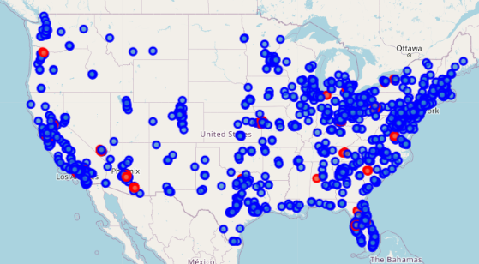
Dataset and preprocessing
The dataset of all Chipotle locations in the United States was made available through Kaggle
The data for the venue and its neighborhood was extracted using the Foursquare API
Supplementary data used was for Number of locations, Annual Revenue, and Top locations
Kaggle data of US locations with most popular franchisees in red

Slide 4
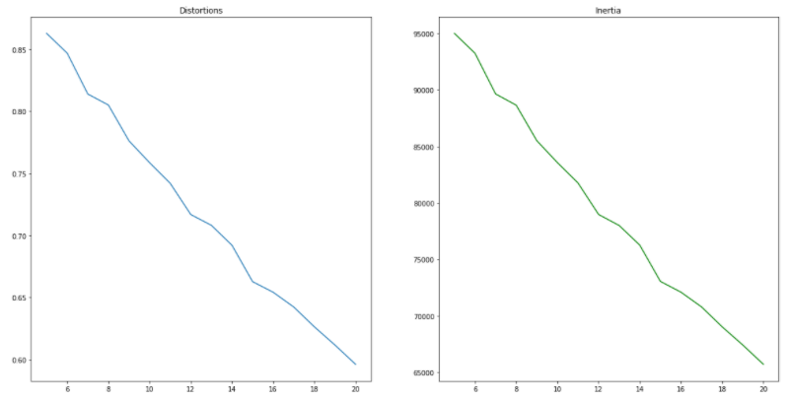
Dataset clustering
Based on the centroids for all the clusters except the main one, the respective venue is found.
The top 10 venues are listed for top and normal locations with not much difference.
Rank | Top Locations | Other Locations
1 | Clothing Store | Mexican Restaurant
2 | Mexican Restaurant | Clothing Store
3 | Coffee Shop | Sandwich Place
4 | Sandwich Place | Fast Food Restaurant
5 | Pizza Place | Pizza Place
6 | American Restaurant | American Restaurant
7 | Cosmetics Shop | Mobile Phone Shop
8 | Bar | Furniture / Home Store
9 | Shipping Store | Convenience Store
10 | Jewelry Store | Frozen Yogurt Shop
Elbow method plot of Distortion
The clustering algorithm doesn’t succeed since there are multiple venues.
Most places have diverse venues falling in the main cluster
However, it separates dimensions (venues) that have the highest frequency into separate clusters.

Slide 5
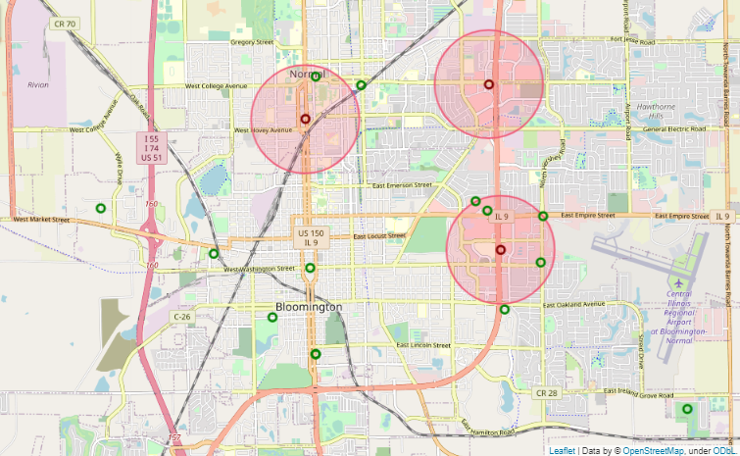
locations in bloomington
The top and other locations had similar venues and based on the analysis, we found that present locations have the following:
NOT NEAR
CHIPOTLE
MEXICAN
RESTAURANT
OTHER
RESTAURANTS
There are 3 franchisees already operating
Those regions and other impractical areas are rejected.
Location of all Mexican restaurants in Bloomington with operating Chipotle locations shown in red
The possible areas to explore are in the South (Downtown)
and South-West regions

Slide 6
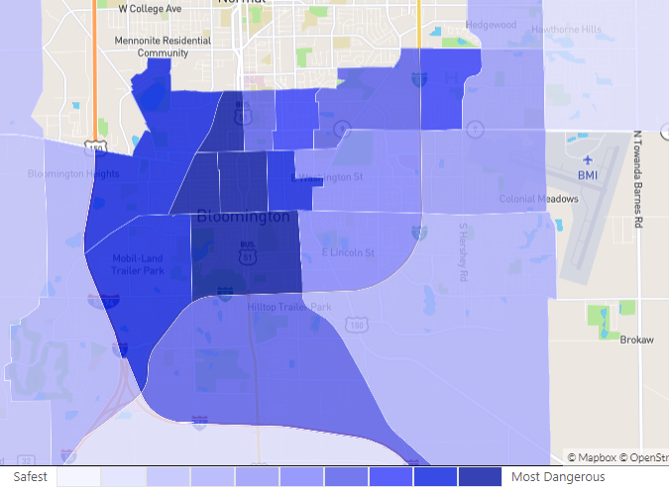
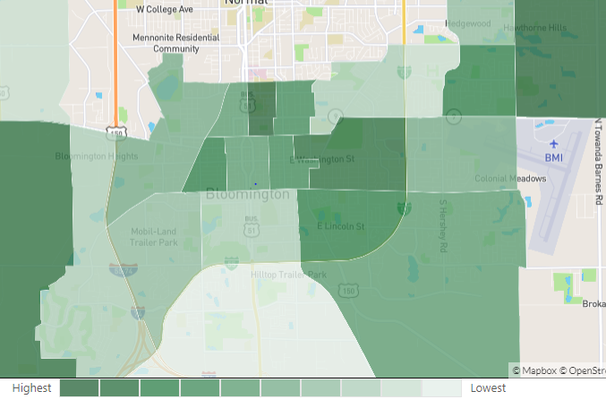
Analysis of the chosen regions: SW region is preferable
Downtown area has some of the lowest land prices in the area
VESTIBULUM ANTE IPSUM PRIMIS IN FAUCIBUS ORCI
But the Downtown area also has the highest crime rates in the region

Slide 7
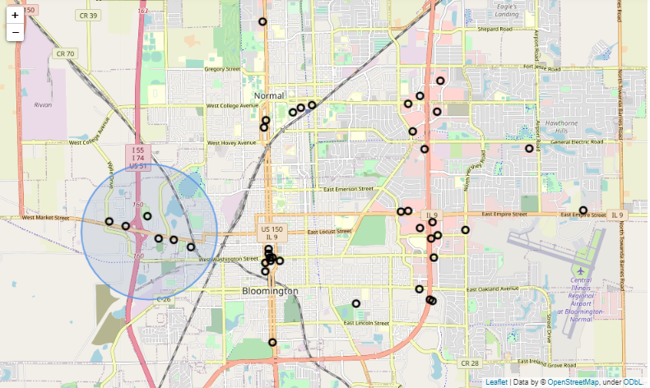
The south-west location chosen
Focusing on the South and South-West regions, its found that:
The South has a large cluster of restaurants where there will be high competition
Other than that, the Downtown has sparse amount of other restaurants
In the South-West region, there are plenty of restaurants scattered.
Also, the region is a good match since the other establishments are similar to Chipotle in terms of expensiveness and target population
Location of other restaurants in Bloomington
Selected region is highlighted

Slide 8
conclusion and future steps
NEXT STEPS
PRESENT SOLUTION
Next steps must entail improved data collection and data about the city to carry out a thorough analysis along with investors cost and other constraints.
Present analysis using clustering provided us with the common venues of other locations
Based on geographical, price and safety constraints, we selected the South-West region as the region for next franchise in the city
Finally, a detailed analysis of site, cost and footfalls in the region must be done to prepare a formal draft proposal

Slide 9
THANK YOU

